Slide 1
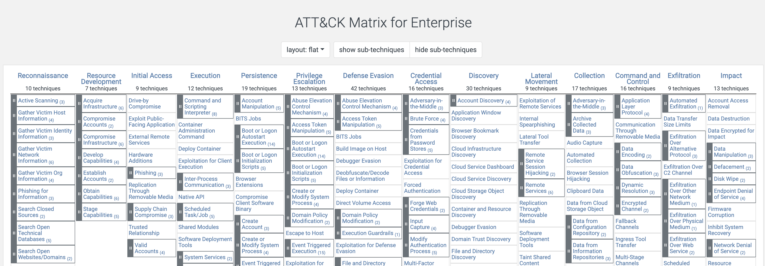
MITRE ATT&CK
https://attack.mitre.org/
Today we will be looking at Command and Control.

Slide 2
Command and Control

Slide 3

Command and Control
What is C2?
C2 is how an adversary gives instructions to, receives data from, and controls the actions of compromised hosts.
Often this includes the use of covert communication methods to make the C2 traffic look like regular/expected network traffic in an environment.
Some Examples:
Remote Access Software (e.g., Log Me In, Team Viewer).
Web sites including social medial and cloud storage can stage instructions, tools and secondary payloads.
Use of bot nets, sometimes including large distributed networks of compromised systems.
Using proxying, protocol tunneling, and the use of non-standard ports to disguise communication with compromised assets.

